Slide 1
Physical Landscape

Slide 2
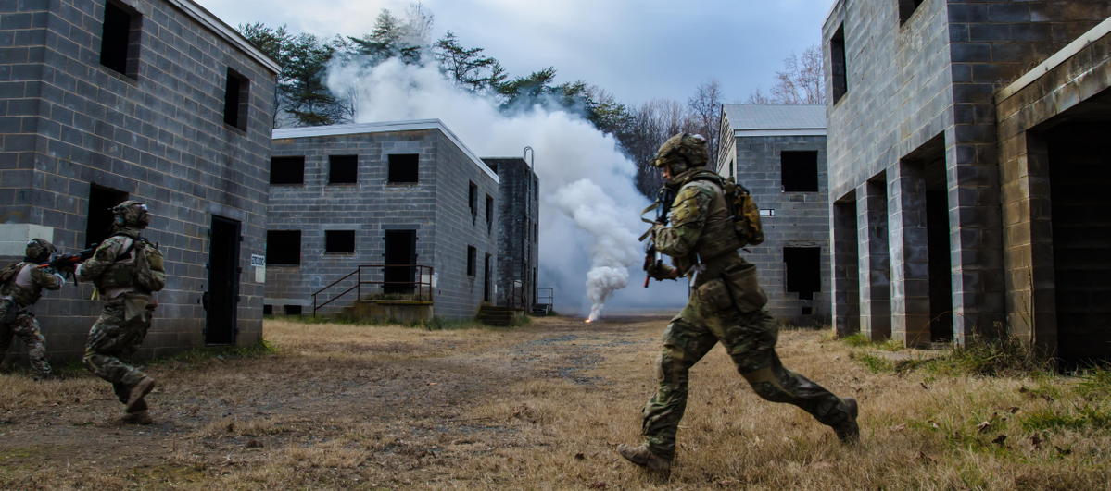
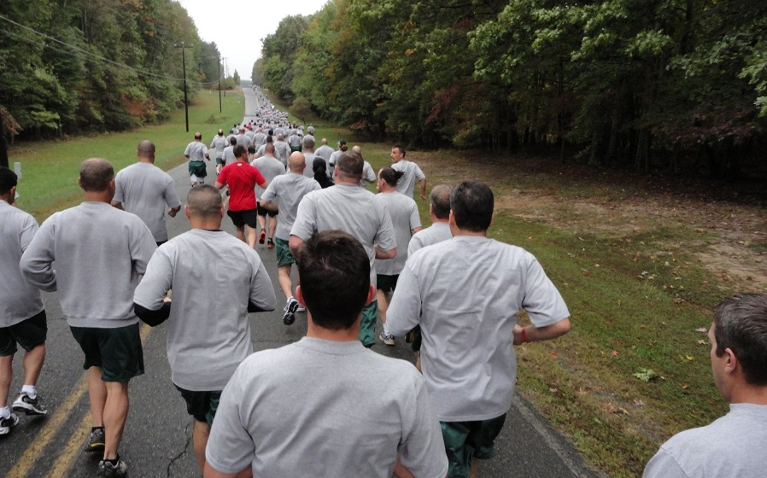
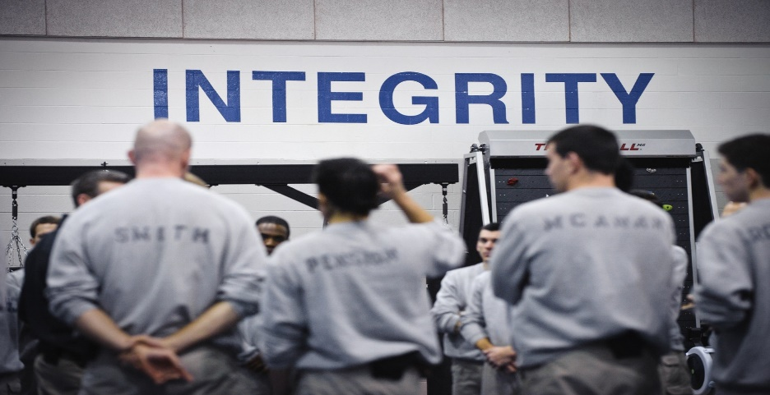
MY Passion

Slide 3
NOTHING ELSE MATTERS

Slide 4
It will always be about who

Slide 5
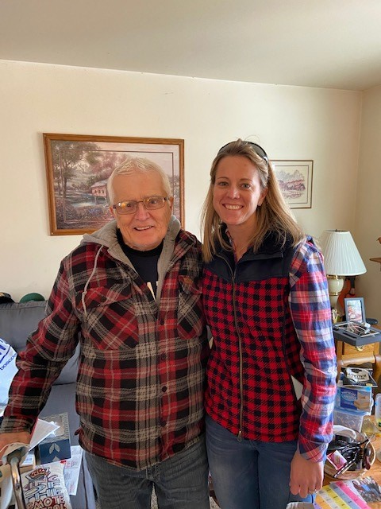
Our CORPSMAN

Slide 6
Health vs. Wealth Mindful vs. Mindless Construct vs. Destruct

Slide 7
Win Each Day
Ability – Investment w/ Effort
Motivation – Family/Friends
Opportunity - 23.5
Direction – Constructive/Destructive

Slide 8
Officially Supercharged!

Slide 10
“The shorter your sleep, the shorter your life.”
- Dr. Matthew Walker

Slide 11
Dr. Metta Singh – Henry Ford Sleep Center
“You cannot talk about mental health without sleep having a seat at the table.”

Slide 12
Human Performance Domains
Cognitive
Physical
Social
Emotional

Slide 13
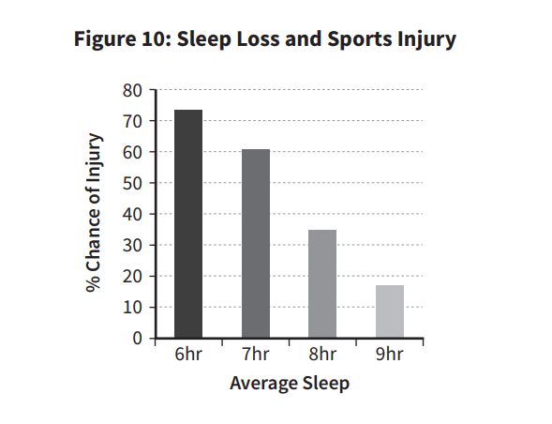

Slide 14
NBA Basketball Player
8
8
12% minutes played
29% points/min
2% 3 point %
9% free throw %
37% turnovers
45% fouls committed

Slide 15
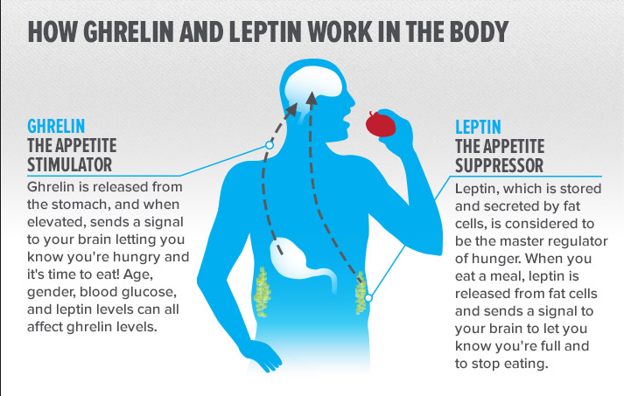

Slide 17
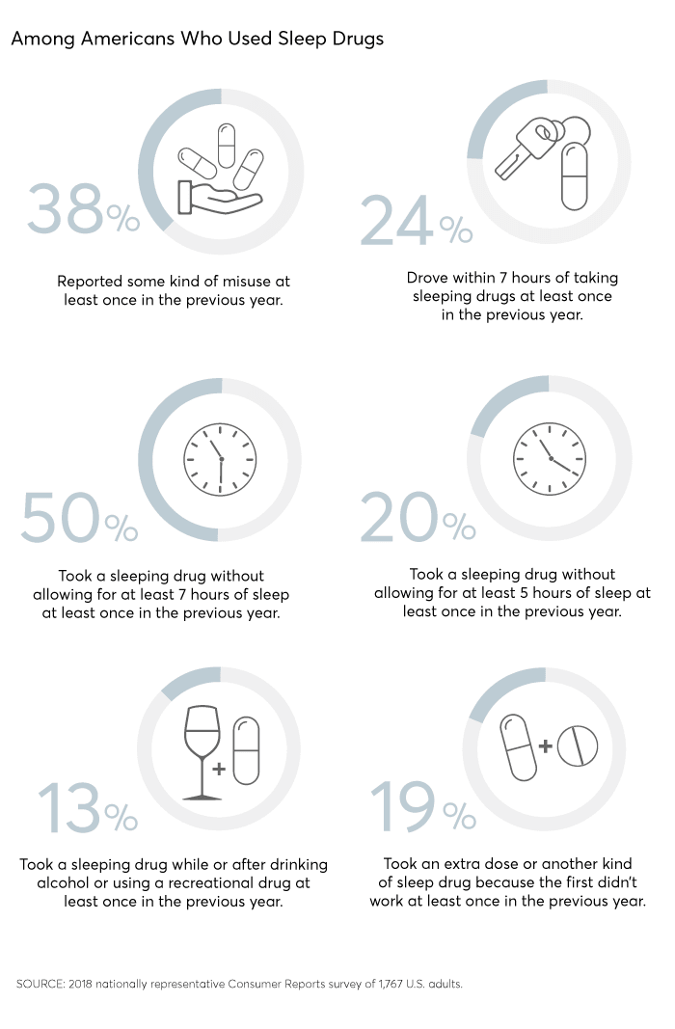
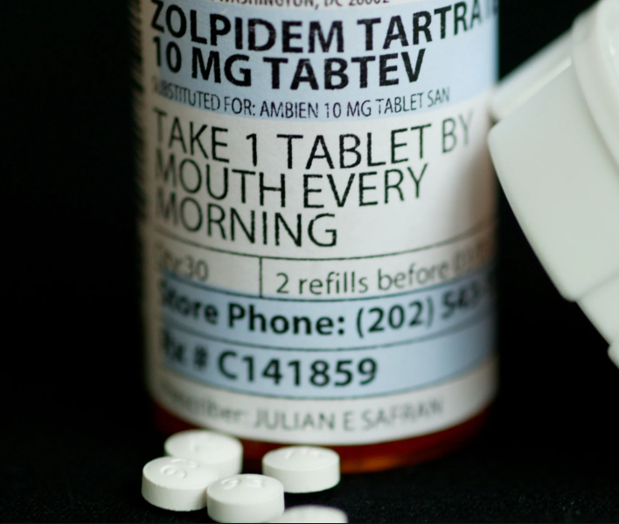

Slide 18
12 Tips to Sleep Better (from Why We Sleep)
1. Commit and stick to a sleep schedule
2. Exercise daily, but not too close to bed time
3. Avoid caffeine and nicotine
4. Avoid excessive alcohol consumption
5. Avoid large meals close to bed time
6. Avoid medications that delay or disrupt sleep patterns
7. Don’t take naps after 3:00 p.m.
8. Downshift mentally before bed time
9. Hot shower/bath before bed
10. Engineer your sleep environment (dark, cool, quiet, comfortable and gadget-free) 11. Get regular sunlight exposure to anchor your circadian clock) 12. Don’t lie in bed awake for more than 20 minutes

Slide 19
Matthew Zanis Physical Therapist
“The breath is the king/queen of the brain
The brain is the king/queen of the body.”

Slide 20
A Weakness or Weapon

Slide 21
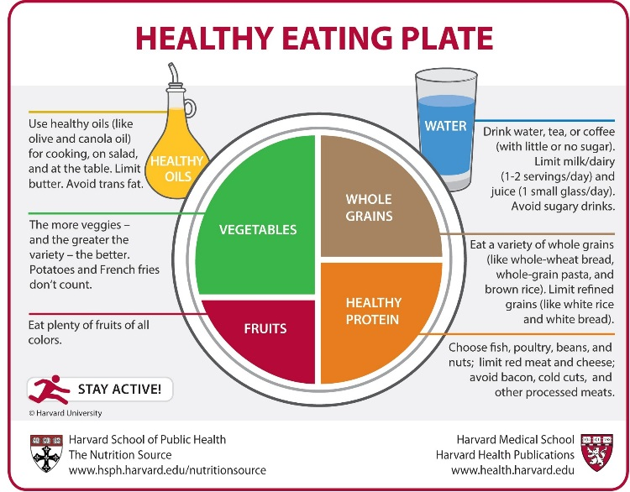
Reduction Business
Eat to Train!
Be that Farmer

Slide 22
Limiting Factor #1 – Food Choices
Too many processed foods
Not enough nutrient-dense, minimally-processed foods
Not meeting basic nutrient needs (macro- & micro-)
Dehydration/poor beverage choices

Slide 23
The Threat

Slide 24
Trust?

Slide 25
The Next Day!
40% loss of strength
50% loss of glycogen
70% loss of Human Growth Hormone

Slide 26
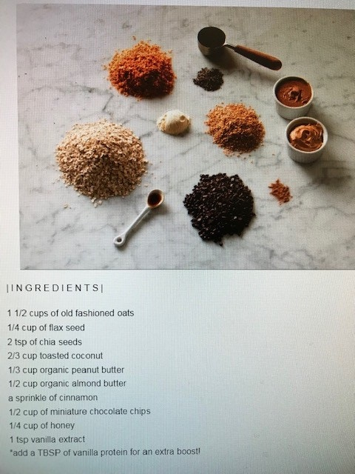
Fueling Tactics
Precisionnutrition
Amount
Type
Timing

Slide 27
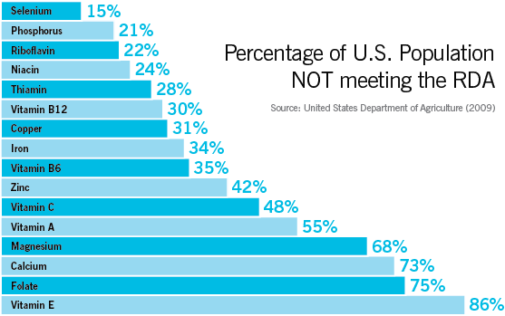

Slide 28
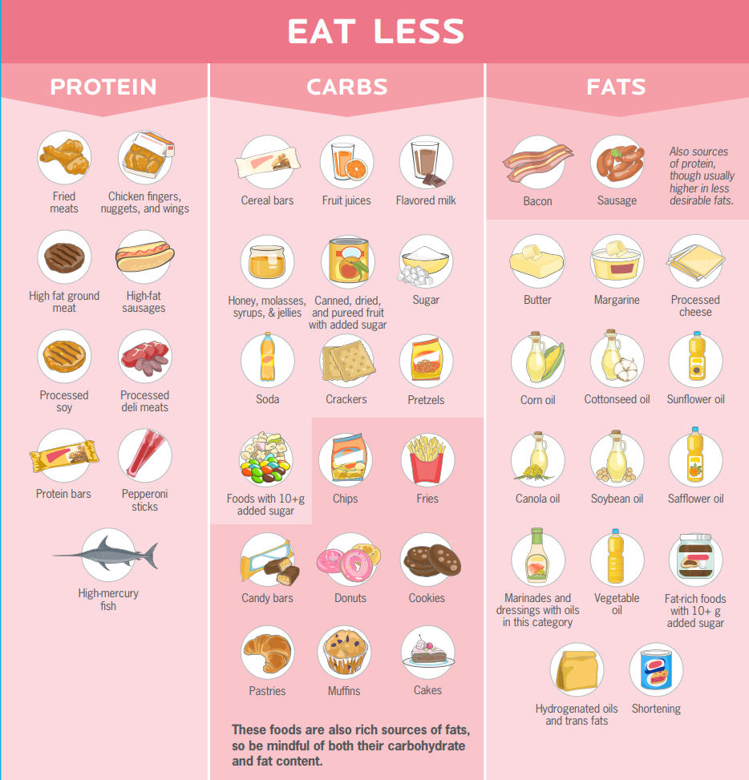

Slide 29
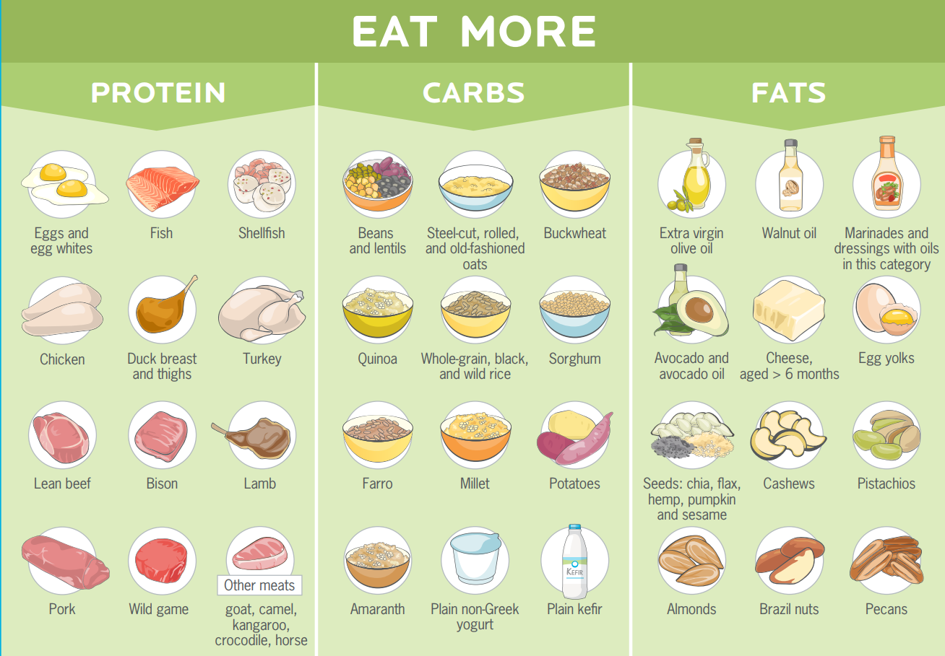

Slide 30
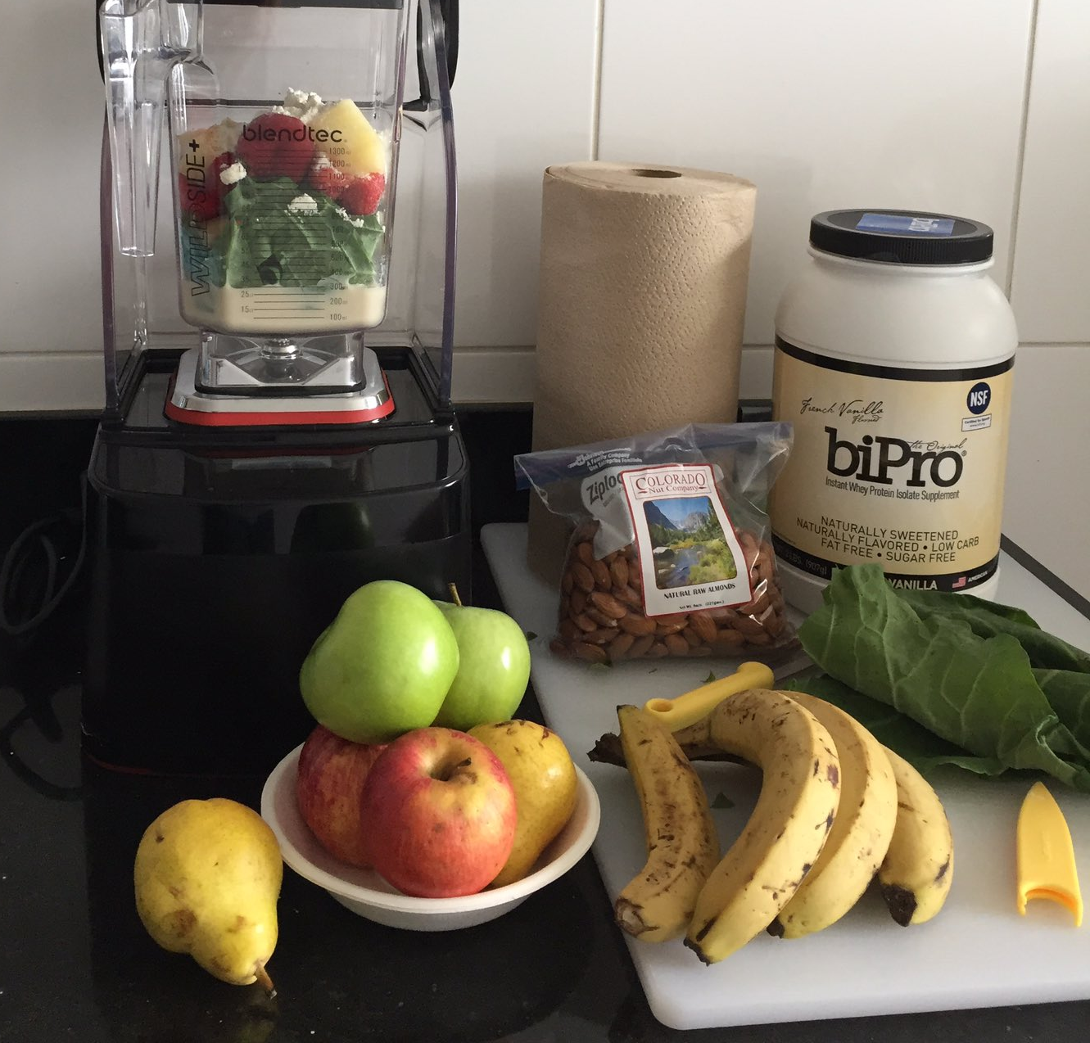

Slide 31
My Immune response
Spinach
½ banana
½ avocado
MaraNatha PB
blueberries/blackberries/strawberries/cherries
Muscle Milk Powder ½ scoop (NSF)
Ice/Milk
Honey

Slide 32
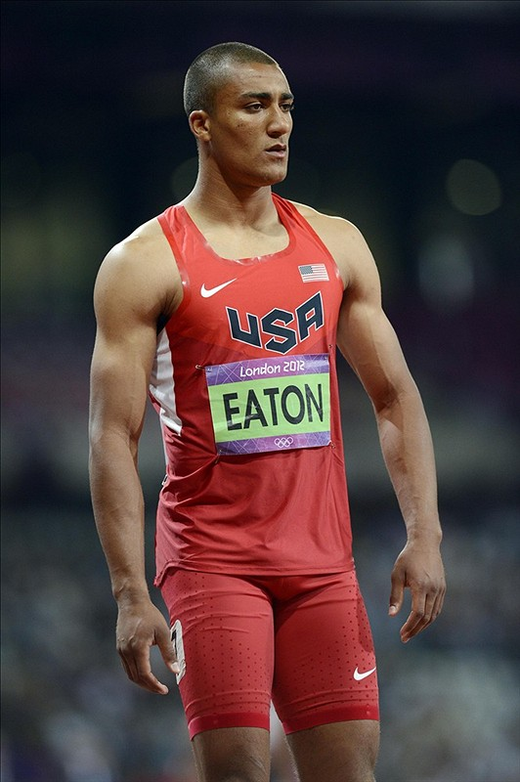
Methodology

Slide 33
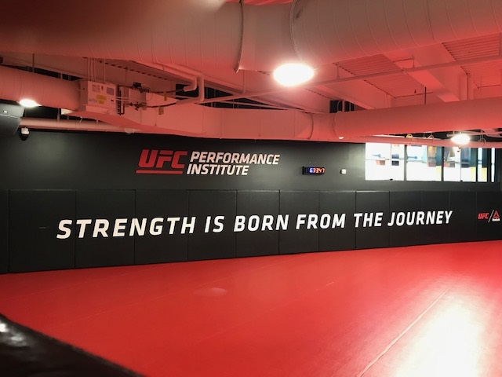
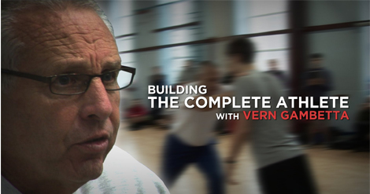
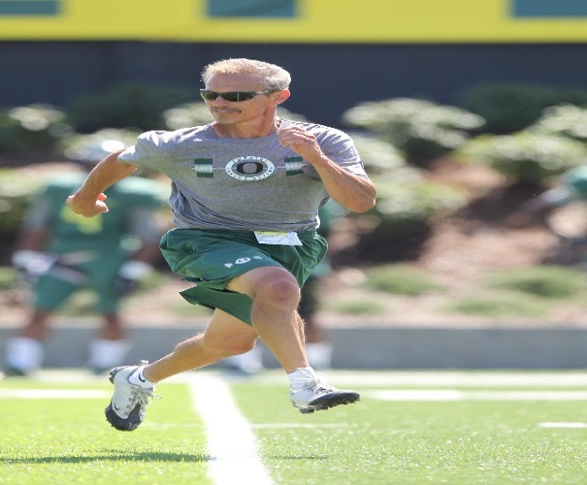
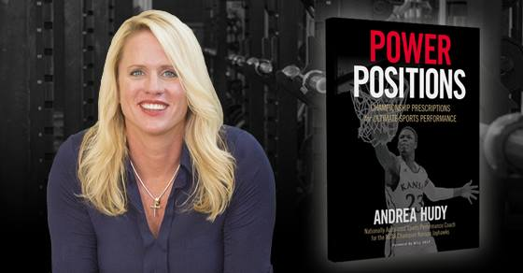
Learn From The Best

Slide 34
Survive not Thrive

Slide 35
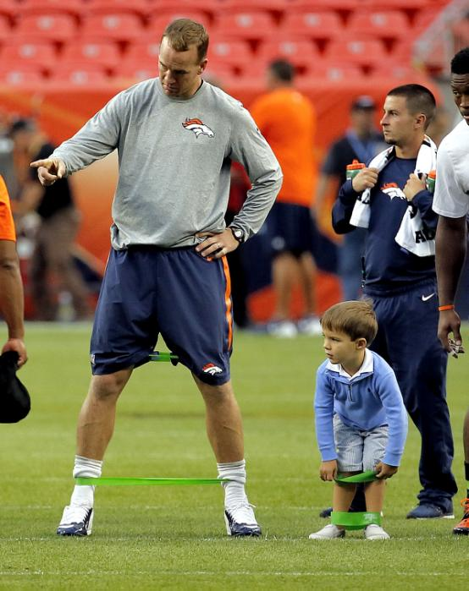
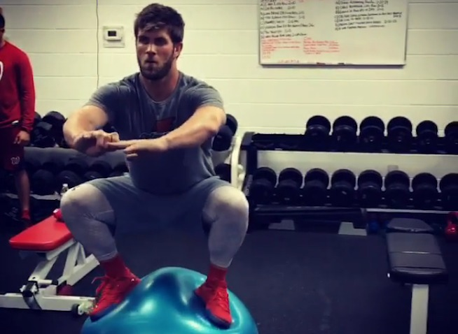
Construction Destruction

Slide 36
Simulation Trap
Principles not Preferences
Monkey See – Monkey Do
Embrace the Pain
Something is better than Nothing
Reality – Synergistic Relationship in all Fitness Modalities

Slide 37
Abouttobehurt.com
Lose Ankle Mobility = knee pain
Hip Mobility = low back pain
Thoracic Mobility = neck/shoulder/low back pain

Slide 38
Assess, not Guess

Slide 39
Dr. Stuart McGill
“The most successful programs appear to emphasize trunk stabilization through exercises with a neutral spine while stressing mobility of the hips.”

Slide 40
The Goals for the Tactical Athlete
Adaptable, not adapted
Resilient & Durable
Confident & Creative
Educated in Self Care (short/long term)
“Never let your physical conditioning be the reason for defeat” Dan Gable

Slide 41
Principles, Not Preferences
Movements, not muscles
Quality then capacity
Gravity is undefeated
Inside out
Progression

Slide 42
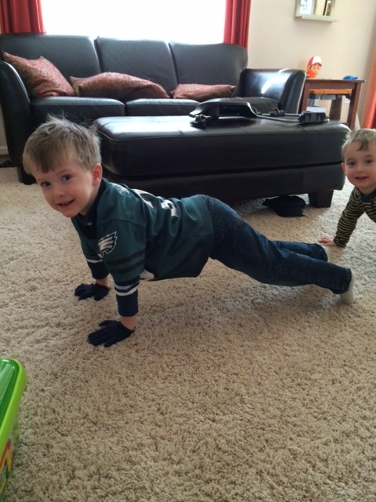
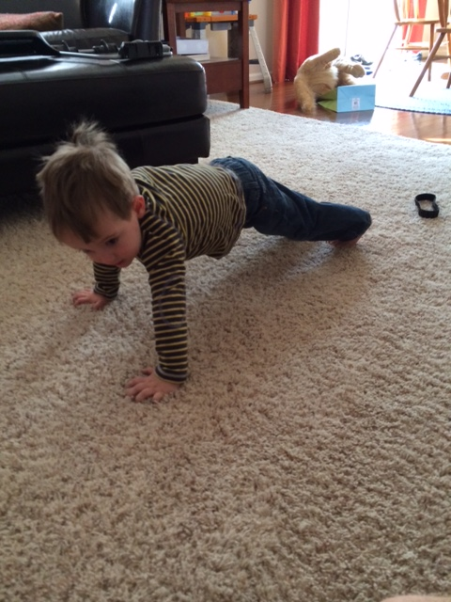
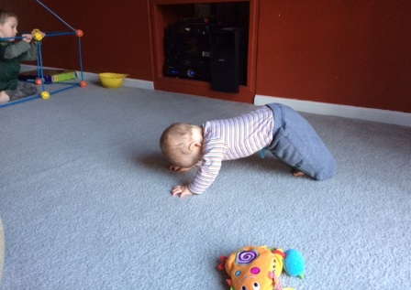
Physical Literacy
Mobility/Stability
Rotation
Changing Levels
Pull/Push
Assistant
Grad Assistant
Intern

Slide 43
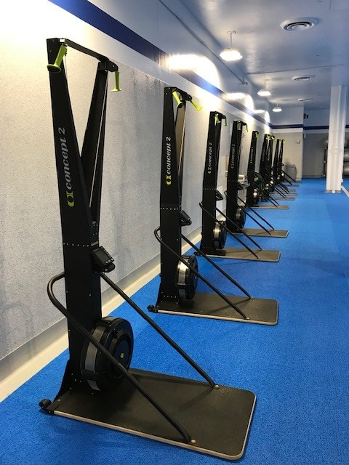
Unbreakable

Slide 44
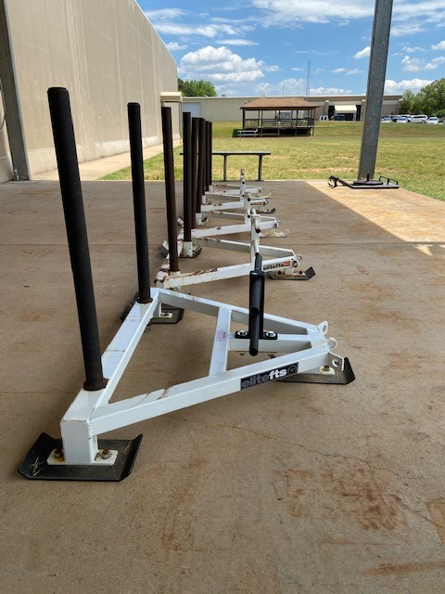
NO VACCINATION

Slide 45
The Kettlebell
Goblet Squat 50% = 20 reps
Farmer Carry 75%/2 = 2min Walk

Slide 46
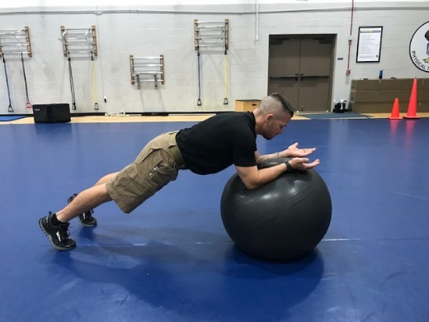
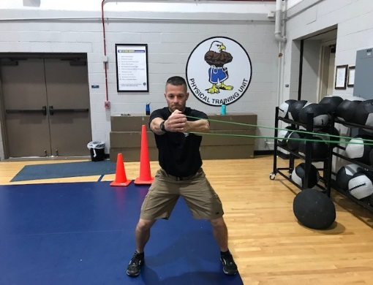
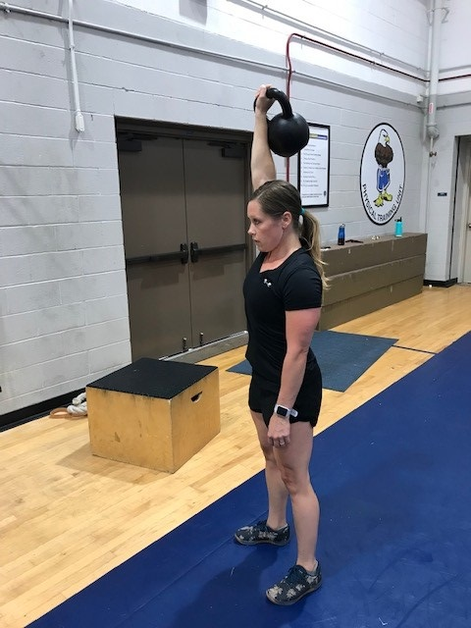
The Stone Wall
Stir the Pot
Band Punch
Vertical Core
Crawl/Carry

Slide 47
The Minimum Dose
Carry
Lift
Pull
Lunge/Hinge
Throw

Slide 48
Your Re-Start
3x20 seconds, recover 2 min = 10 minute commitment (2 min warm-up, 3 min cool-down) McMaster Univ. 2014
Wingate Test – 30 sec, 4-6 reps = 3xWeek
30/20/10 – 5:00 w/ 2” recovery
Easy/Moderate/HARD

Slide 49
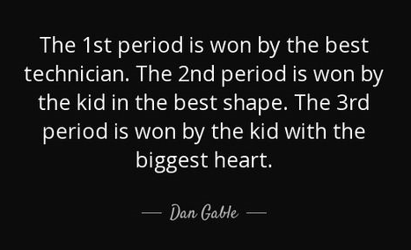
The Spirit World
Minute 1 – Squats, Lunges, Jumps, Split Jumps
Minute 2 – Pushups, Mountain Climbers, Planks
Minute 3 – Crab Crawls, Bridging, Supine Planks
Minute 4 – Base Switches/Hip- Unders, Rotational Planks
Minute 5 – Up Downs, Burpee v2.0, Squat Thrusts
Five minutes per round, or cycle
One minute recovery between rounds
Three rounds total
Total Time – 17:00

Slide 50
Remember this…
What we inherit loads the gun, what we choose pulls the trigger

Slide 51
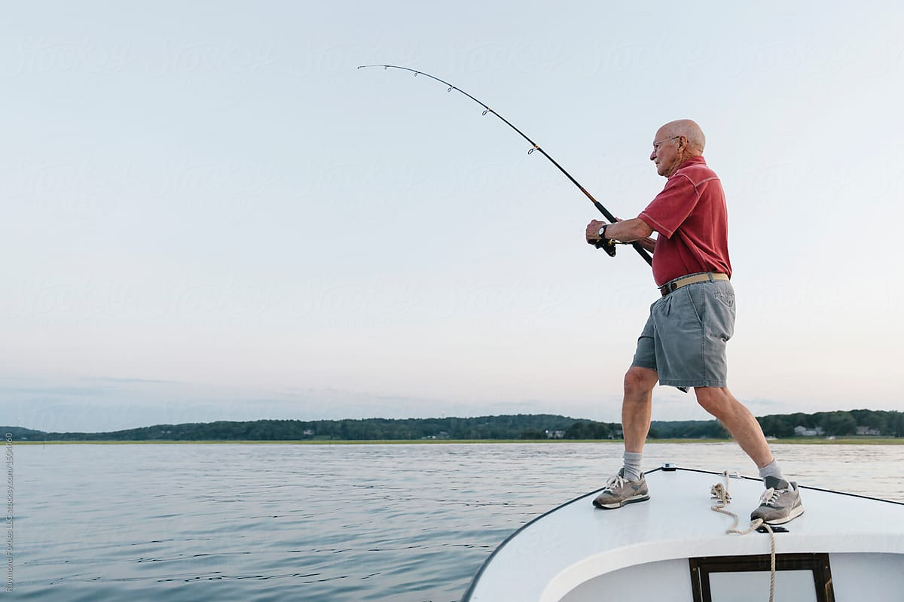
Stack the odds in your favor

Slide 52
The Checks vs. The Size

Slide 53
Ask away or I will sing!
E.J. O’Malley
ejomalley@fbi.gov

